Slide 1



Metadata & Findability
Author: Bruna Piereck and Alexander Botzki
Version: 092024

Slide 2


Findability
Human findable
Machine findable
Notes:
https://www.freepik.com/icon/search_1705952#fromView=search&page=1&position=70&uuid=c9baea82-896a-4cee-bab6-c0bbb3af08a1
https://www.freepik.com/icon/technological-support_2408695#fromView=search&page=1&position=0&uuid=e9efa965-f219-42be-9003-dfd577db3888
https://www.freepik.com/icon/search_1705952#fromView=search&page=1&position=70&uuid=c9baea82-896a-4cee-bab6-c0bbb3af08a1

Slide 3
What do you know about metadata?
?
example from Niall Beard

Slide 4



What is Metadata
Data to describe Data
Structured data
Descriptor with clear meaning
“Love note to the future about data”
example from Niall Beard
Notes:
https://www.freepik.com/icon/dictionary_12349225#fromView=search&page=1&position=11&uuid=947d3a74-8e87-4cba-952c-b5f3187bbd5c
https://www.freepik.com/icon/bricks_7007832#fromView=search&page=1&position=0&uuid=ab1d4a89-296c-44cd-89dc-5cc08e358eb4
https://www.freepik.com/icon/note_6546748#fromView=search&page=1&position=25&uuid=82875b0e-a9dc-4170-ad8f-bdc032877650

Slide 5
General structure of Metadata
Property A
Property B
Property C
Property D
etc
Properties
Profile
Type
One example …. →
example from Niall Beard

Slide 6
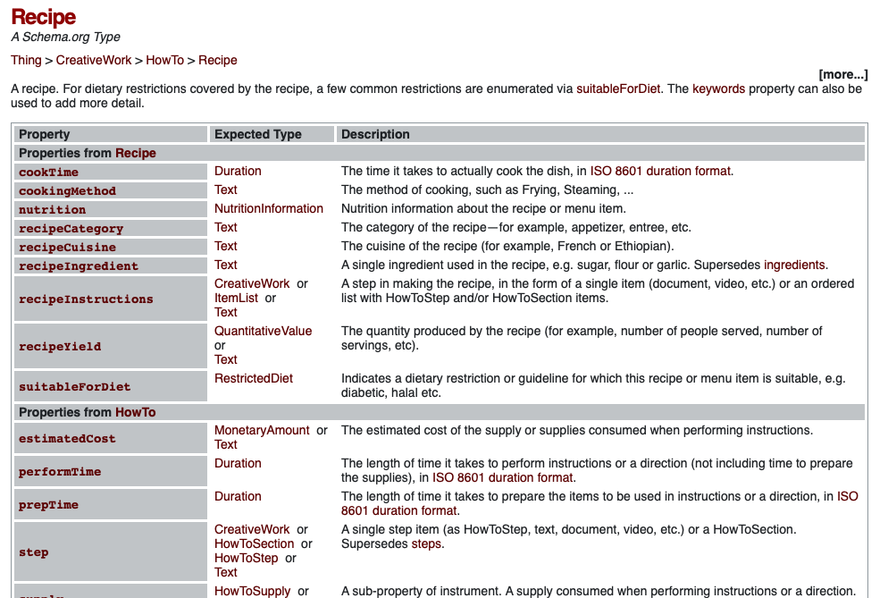
Type
Profile
example from Niall Beard

Slide 7
Type
Profile
example from Niall Beard

Slide 8
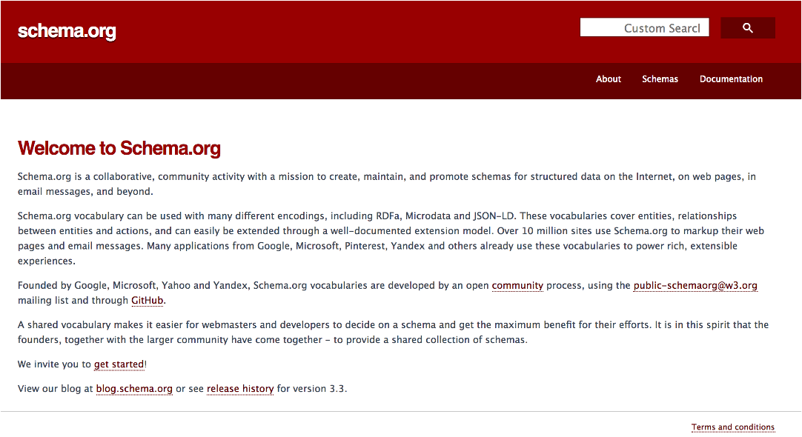
Schema.org
A consortium:
Describe online information
Improve search efficacy
Controlled vocabulary
Metadata for the world
Several profiles

Slide 9
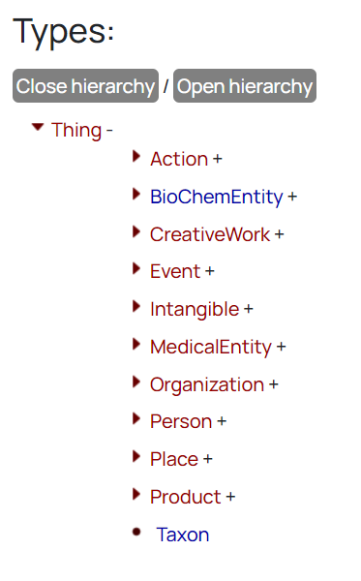
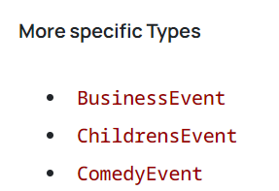
Schema.org
Profile
Property | Expected type | Description
about | thing | …
actor | person | …
attendee | Person or Org | …
etc …

Slide 10
What training types exist
?
example from Niall Beard

Slide 11
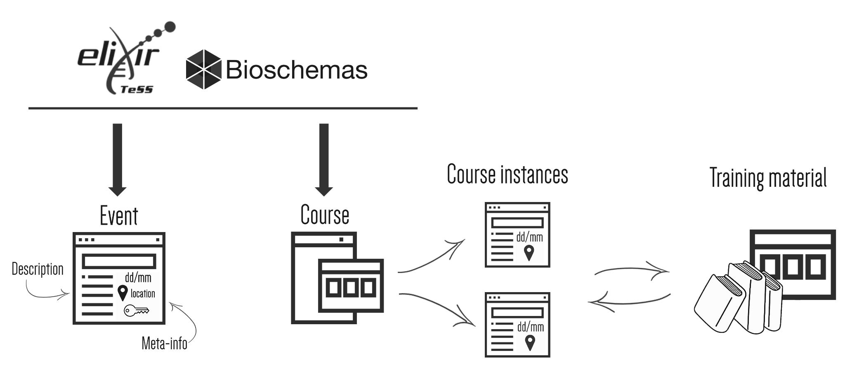
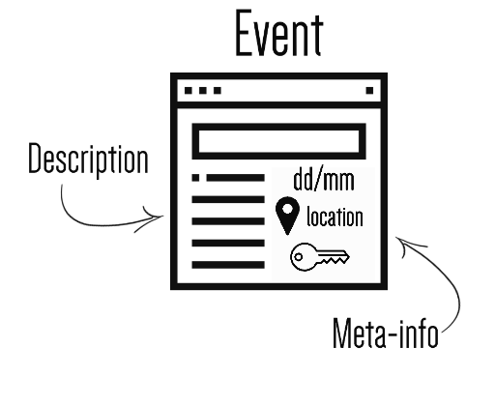
Types for training

Slide 12
Types for training
Course:
FAIR training material made by design

Slide 13
Types for training
Course:
FAIR training material made by design
Course instance:
Sept 2024 - SE
Sept 2025 - BE
Sept 2026 - IT

Slide 14
What properties there are in each profile
?

Slide 15
example from Niall Beard
https://bioschemas.org/profiles/
Training minimum properties
Course
Course Instance
Training Material
HAS
FEATURED
Description
Keywords
Name (Title)
Course mode
Location
Description
Keywords
Name (Title)
Minimal
Properties
Profiles

Slide 16
example from Niall Beard
https://bioschemas.org/profiles/
Training minimum properties
Course
Course Instance
Training Material
Description
Keywords
Name (Title)
Course mode
Location
Description
Keywords
Name (Title)
Course
Training Material
Description
Keywords
Name (Title)
Description
Keywords
Name (Title)

Slide 17
example from Niall Beard
https://bioschemas.org/profiles/
Training minimum properties
Course
Course Instance
Training Material
Description
Keywords
Name (Title)
Course mode
Location
Description
Keywords
Name (Title)
Course
Training Material
Description
Keywords
Name (Title)
Description
Keywords
Name (Title)
Training Material
Description
Keywords
Name (Title)

Slide 18
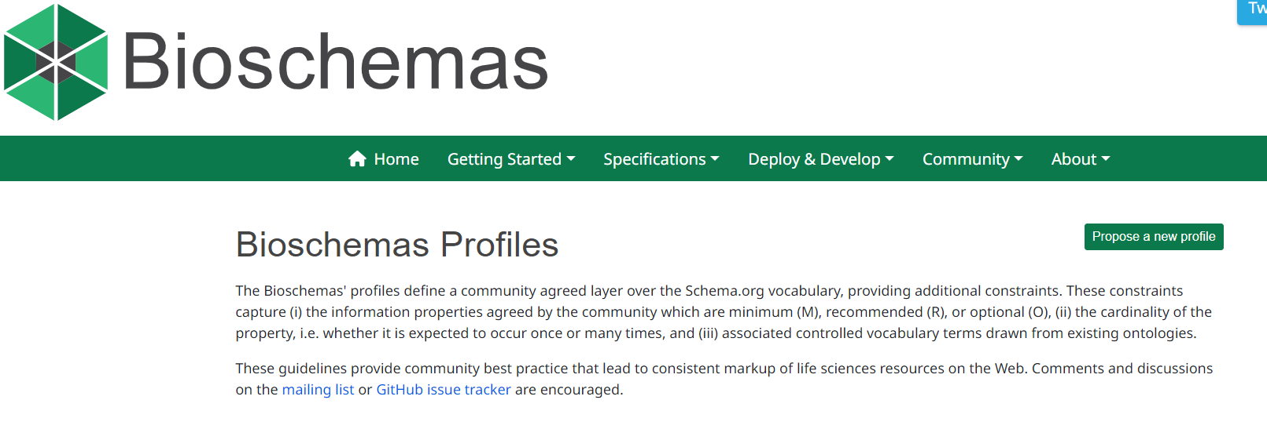
Find out all the properties
https://bioschemas.org/profiles/
Schema.org
Bioschema .org

Slide 19
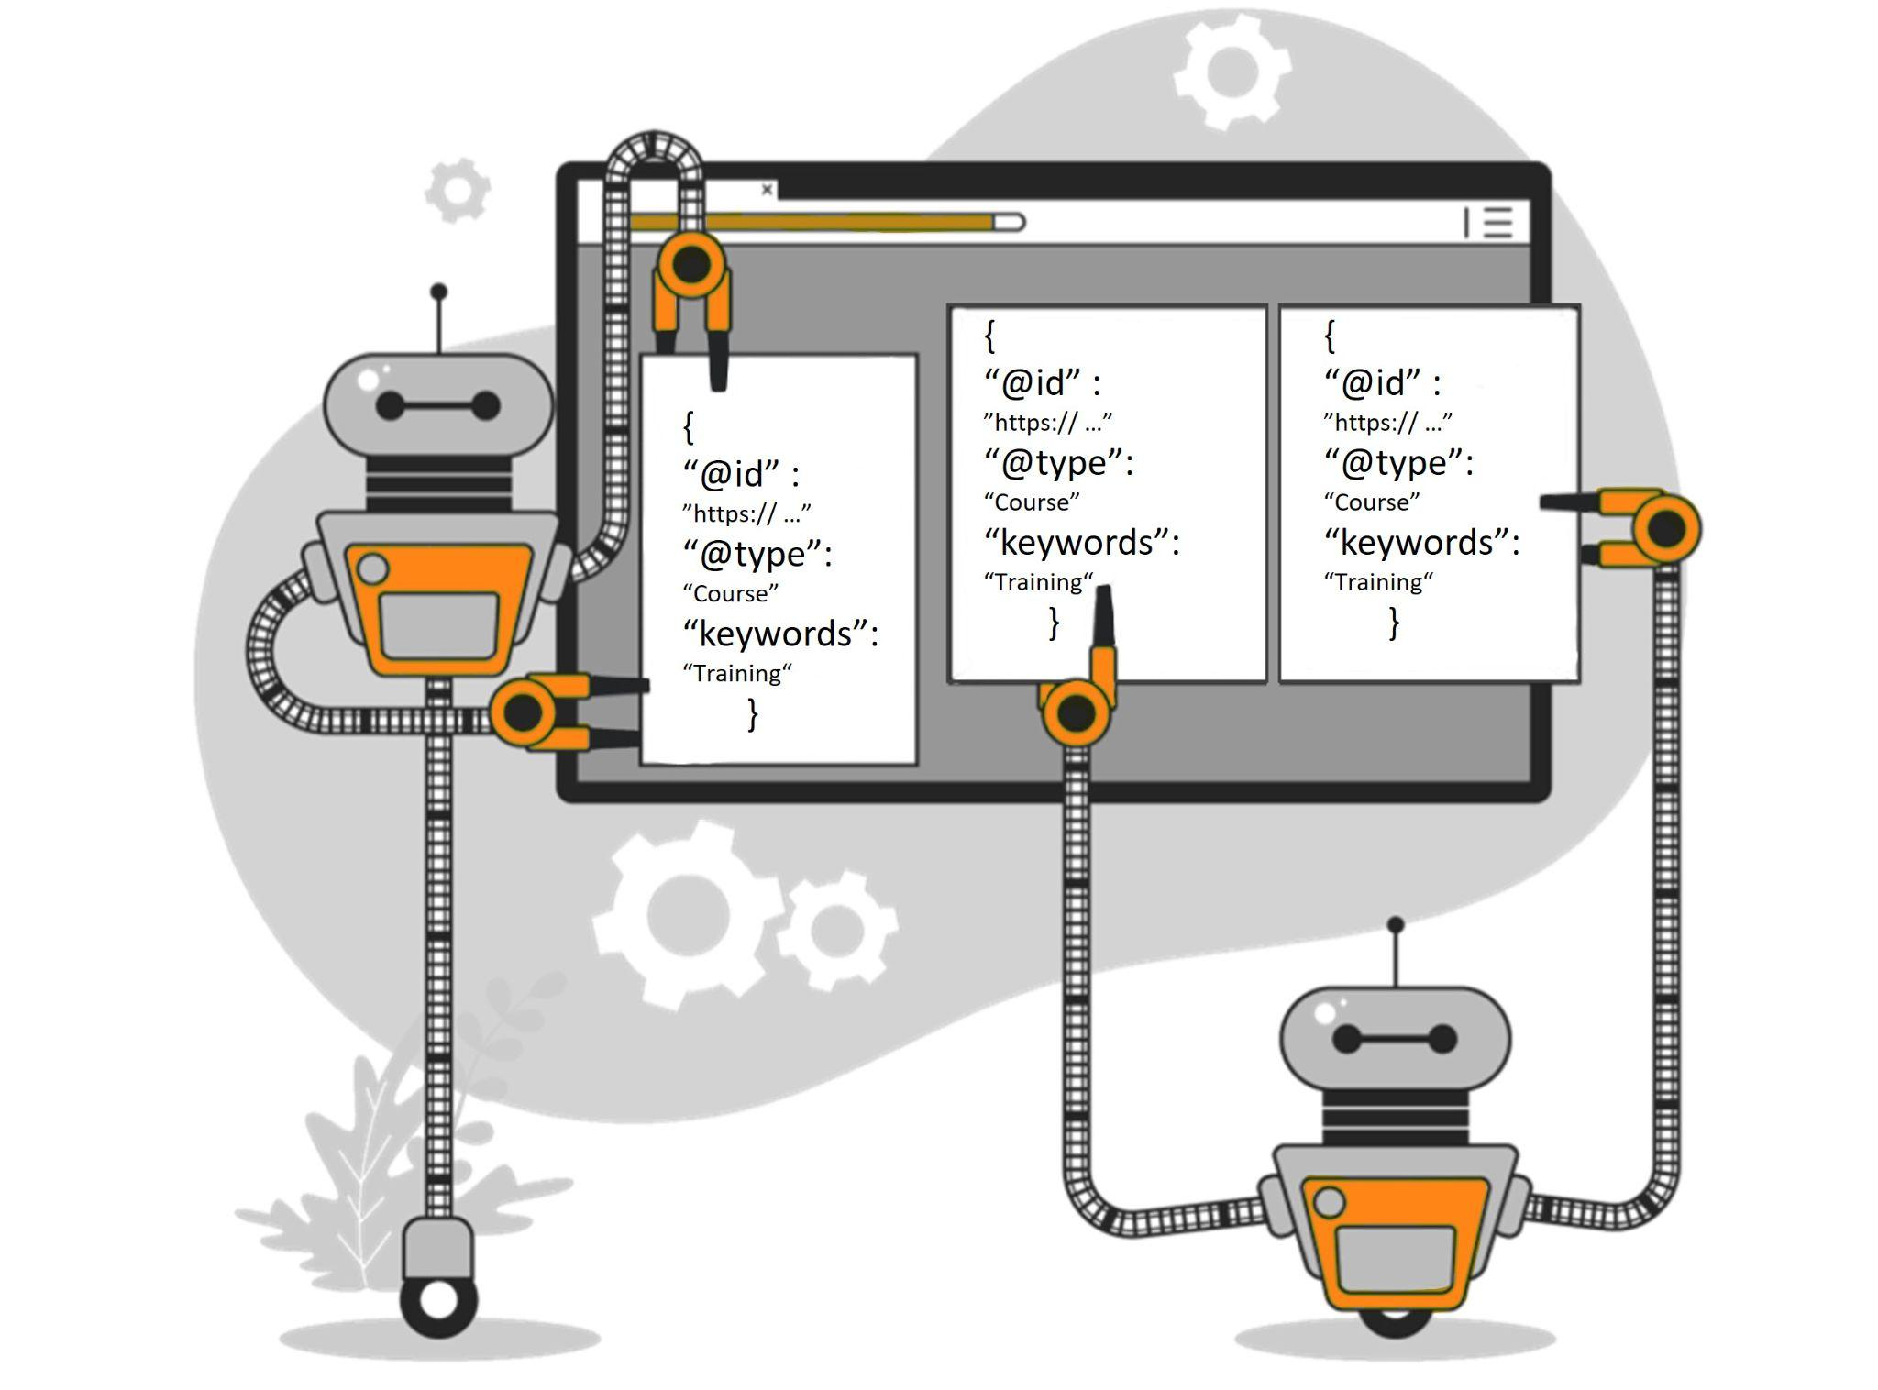
Impacts of Metadata
Notes:
https://www.opendatasoft.com/en/blog/what-is-metadata-and-why-is-it-important-data/

Slide 20

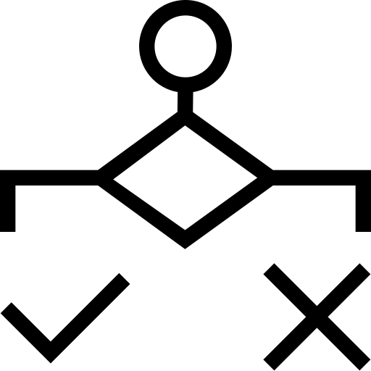
Metadata impact
Findability:
Findable by search engines
Sharing:
Structured information to evaluate
Targeted judgment
Evaluation on reusability
Decision making:
Notes:
https://www.opendatasoft.com/en/blog/what-is-metadata-and-why-is-it-important-data/

Slide 21
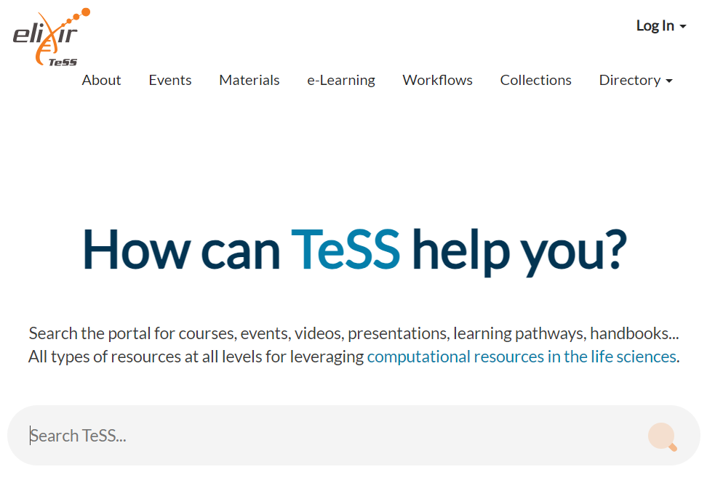

Training e-Support System
Aggregator Metadata keeper !!!

Slide 22

What you can register and find is TeSS portal?
Adapted from @Sketchepedia - freepick.com

Slide 23


What you can register and find is TeSS portal?
Training material
Course plan
Tutorial
Course content
Collections
e
e-Learning course
Adapted from @Sketchepedia - freepick.com

Slide 24
What you can register and find is TeSS portal?
Training material
Events
Courses
Webinars
Congresses/ Symposiums
Adapted from @Sketchepedia - freepick.com

Slide 25
Who is feeding TeSS portal?
Adapted from @Sketchepedia - freepick.com

Slide 26
Who is feeding TeSS portal?
122 Content providers
Academic institutions
non-profit organisations
Other portals
Registered people
Adapted from @Sketchepedia - freepick.com

Slide 27
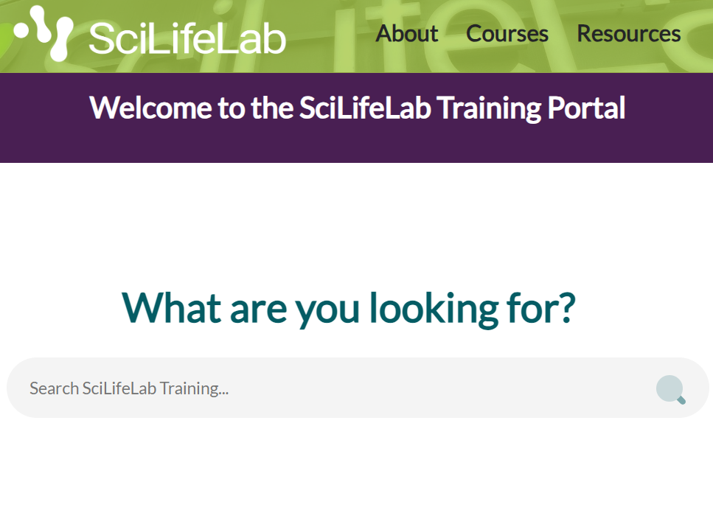
TeSS is open source

Slide 28
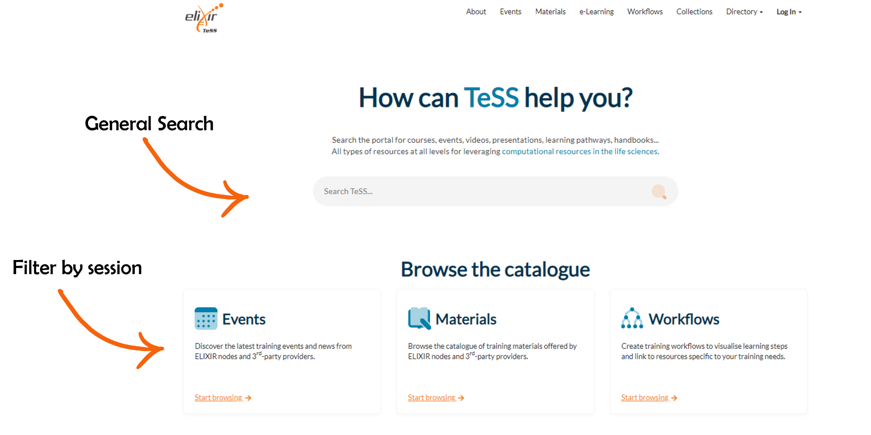

Slide 29
Activity:
Find a training material of intermediate difficulty for single cell data analysis
Find the event “FAIR training material made by design” course
Find active training material of NBIS
List how many archived materials NBIS has
Find when and where VIB will offer a super nice AI event

Slide 30
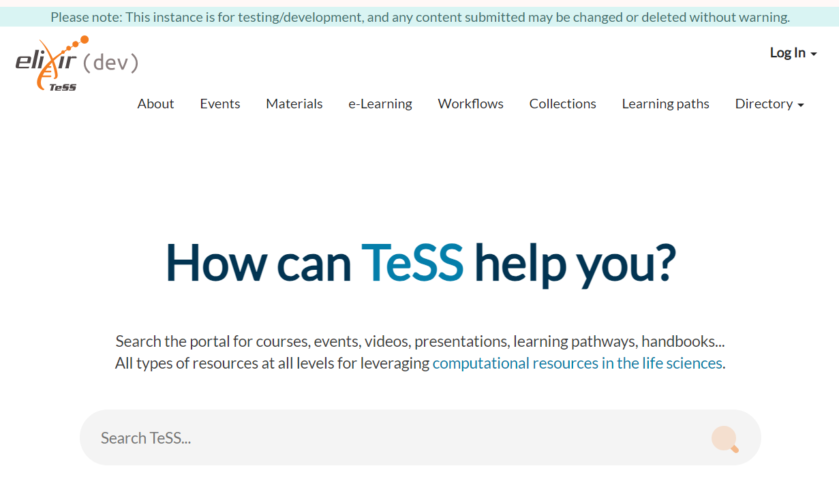
Let’s prepare to register our own

Slide 31
Let’s prepare to register our own
!
Create an account
https://dev.tess.elixir-europe.org/

Slide 32
Many ways to register
Manual Registry

Slide 33
Many ways to register
“Embedded” registry
Automatic registry
Manual Registry

Slide 34
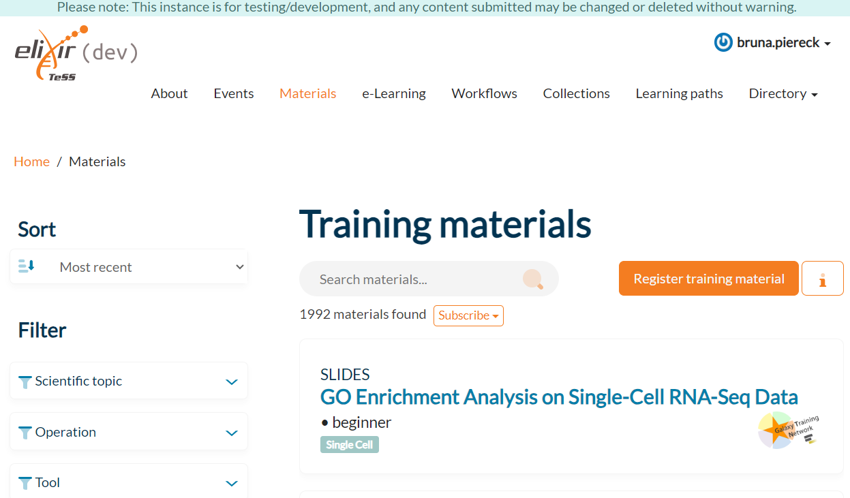
Manual Registration
Manual Registry

Slide 35
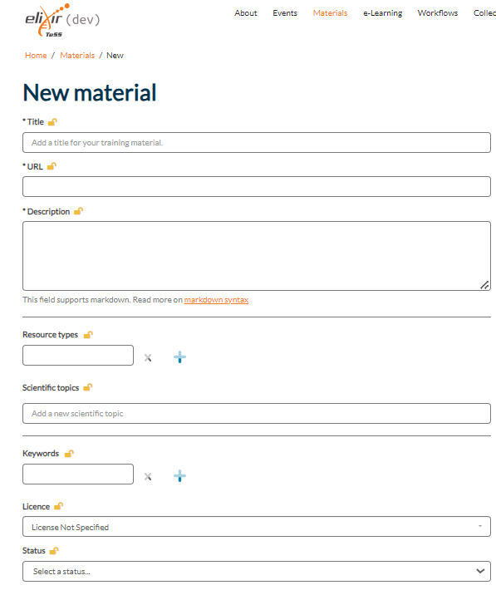
Structured data in disguise
Properties
…

Slide 36
Activity:
Create an imaginary event on dev.tess.elixir-europe.org, later we will link our training material to this event.
Annotate as much metadata as you can for your training
Try to think of what usually you would annotate
I trust you can do more than the minimum
Manually you can not differentiate !
Course
Course Instance
Minimal
Properties
Description
Keywords
Name (Title)
Course mode
Location

Slide 37
Structured data
Structured data
JSON object
Data is in key/value pairs
KEY: VALUE
"author": [
{
"@type": "Person",
"name": "Bruna Piereck"
},
{
"@type": "Person",
"name": "Olivier Sand"
},
{
"@type": "Person",
"name": "Alexander Botzki"
}
],

Slide 38
Structured data
Structured data
JSON object
Data is in key/value pairs
Data is separated by commas
"author": [
{
"@type": "Person",
"name": "Bruna Piereck"
},
{
"@type": "Person",
"name": "Olivier Sand"
},
{
"@type": "Person",
"name": "Alexander Botzki"
}
],

Slide 39
Structured data
Structured data
JSON object
Data is in name/value pairs
Data is separated by commas
Square brackets hold arrays (collection of elements)
Name : [ collection ]
"author": [
{
"@type": "Person",
"name": "Bruna Piereck"
},
{
"@type": "Person",
"name": "Olivier Sand"
},
{
"@type": "Person",
"name": "Alexander Botzki"
}
],

Slide 40
Structured data
Structured data
JSON object
Data is in key/value pairs
Data is separated by commas
Square brackets hold arrays (collection of elements)
Curly braces hold objects
"author": [
{
"@type": "Person",
"name": "Bruna Piereck"
},
{
"@type": "Person",
"name": "Olivier Sand"
},
{
"@type": "Person",
"name": "Alexander Botzki"
}
],

Slide 41
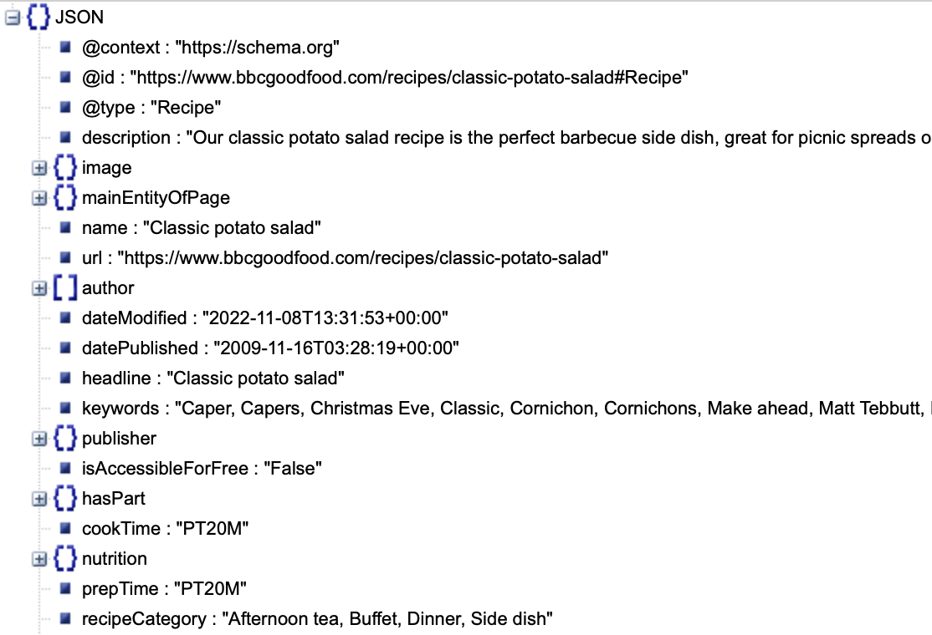
Example of JSON-LD
Example of structured data

Slide 42
I’ll do it for you in the background
Example of JSON-LD
Example of structured data
Adapted from @Sketchepedia - freepick.com

Slide 43
“Embedded” Registration
- JSON object -
“Embedded” registry
Automatic registry
{}JSON
Key:descriptor
Key:descriptor
.
.
.

Slide 44
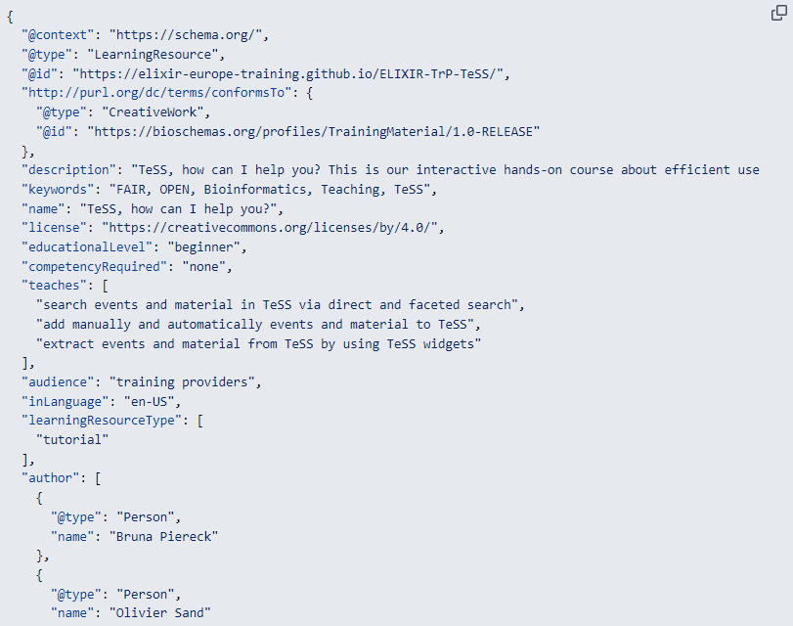

GitHub Octocat, by simon oxley, attribution and non-derivative license

Slide 45
Activity:
Annotate your training material metadata
Annotate as much metadata as you can for your training material
Try to think of what usually you would annotate
I trust you can do more than the minimum
Link this material to the event
Training Material
Minimal
Properties
Description
Keywords
Name (Title)

Slide 46
Activity:
Annotate your training material metadata
Annotate as much metadata as you can for your training material
Try to think of what usually you would annotate
I trust you can do more than the minimum
Link this material to the event
Manual: the tab is a look-up type the title of your material to embed it in the event.
If you are using GitHub, use the template to include all the metadata
GitHub Octocat, by simon oxley, attribution and non-derivative license

Slide 47

Activity:
@Maan Icons in freepik
Extract your JSON file from TeSS
Validate the individual page with the schema.org validator by pasting the URL into the Fetch URL tab.
You will get the the HTML code of the web site on the left side and a list of type from schema.org.
In the HTML code, look for a script element with the attribute type=”application/ld+json”. This script element could be a child of the head element of the HTML page. This results in the following script HTML element.
Copy the JSON object and paste it into a file called course-descr.json

Slide 48
GitHub Octocat, by simon oxley, attribution and non-derivative license
Demo:
Scrape the metadata about the material into TeSS
We will demo how you could set up an automated mechanism to get training material into TeSS.

